Slide 1
Car price prediction project
I would like to express my special thanks of gratitude to my organization (Fliprobo))who gave me the golden opportunity to do this wonderful project on the topic (Car price prediction project ), which also helped me in doing a lot of Research and i came to know about so many new things I am really thankful to them.
About the problem:
With the covid 19 impact in the market, we have seen a lot of changes in the car market. Now some
cars are in demand hence making them costly and some are not in demand hence cheaper. One
Our clients work with small traders, who sell used cars. With the change in market due to covid
19 impact, our client is facing problems with their previous car price valuation machine learning
models. So, they are looking for new machine learning models from new data. We have to make
car price valuation model.

Slide 2
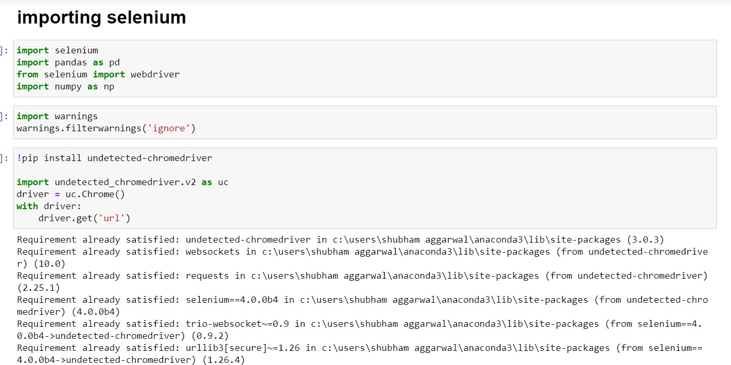
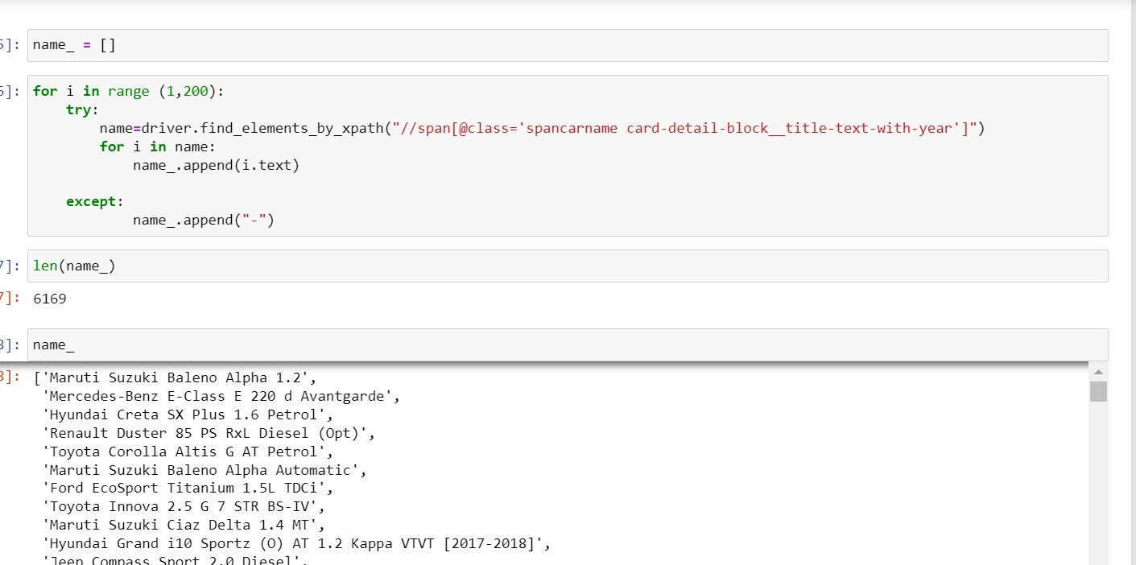
Scraping the data for car names
Scraping the data for price

Slide 3
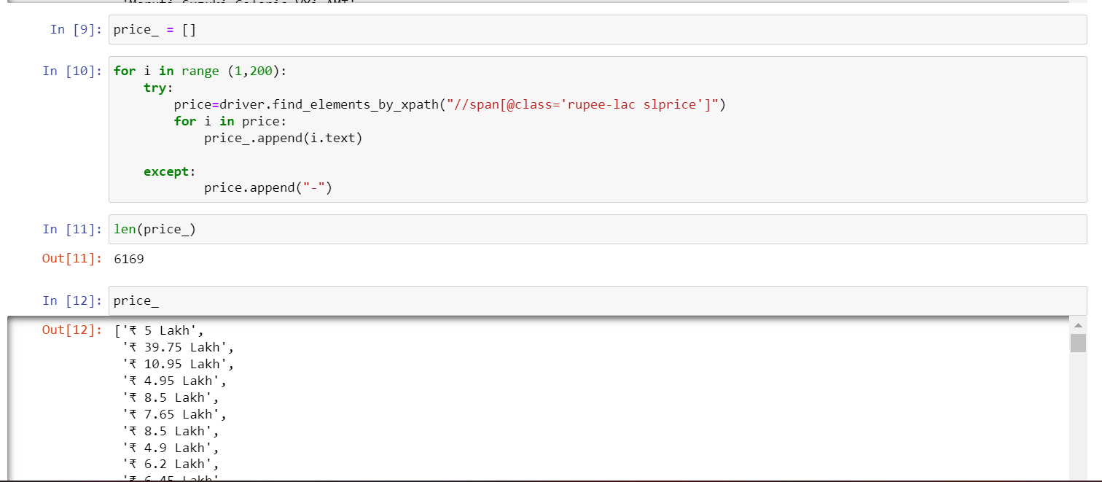
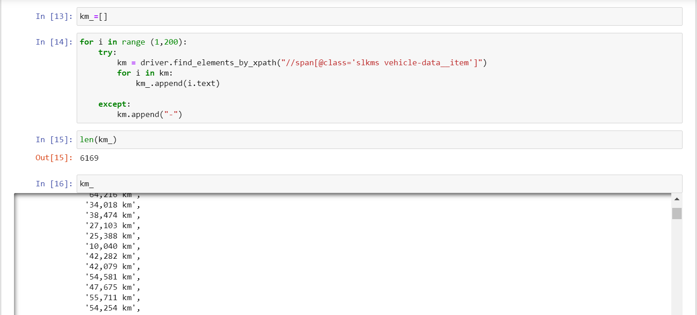
Scraping the range of km that cars are driven
Scraping the type of fuel cars are available

Slide 4
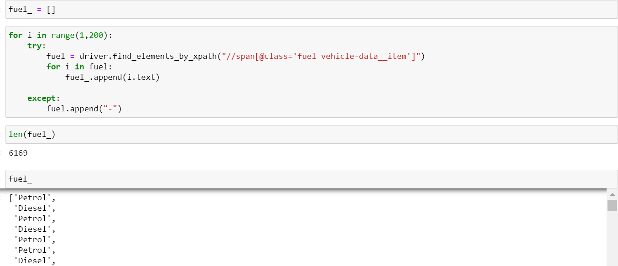
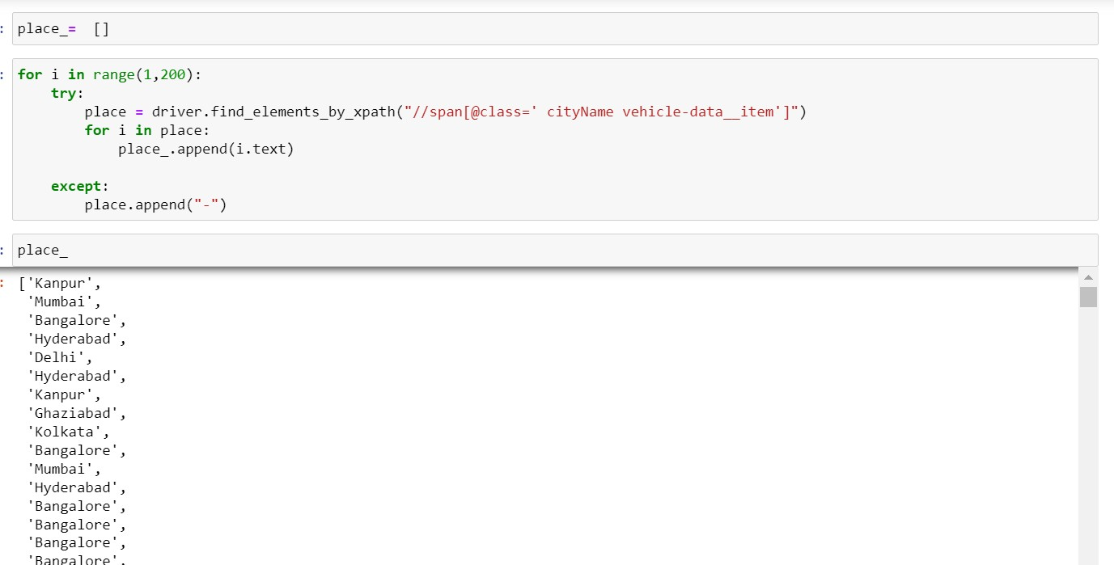
Scarping the Car’s location
Now importing pandas library for making the data frame of the above scraped data and also importing some visualisation tools and library like matplotlib and seaborn

Slide 5
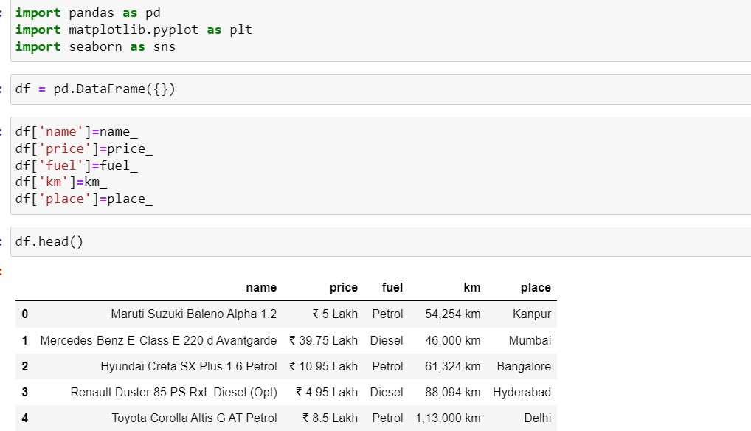
Now performing some EDA (exploratory data analysis ) to gain some insights from the scraped data
About EDA
Exploratory Data Analysis, or EDA, is an important step in any Data Analysis or Data Science project. EDA is the process of investigating the dataset to discover patterns, and anomalies (outliers), and form hypotheses based on our understanding of the dataset.
EDA involves generating summary statistics for numerical data in the dataset and creating various graphical representations to understand the data better. In this article, we will understand EDA with the help of an

Slide 6
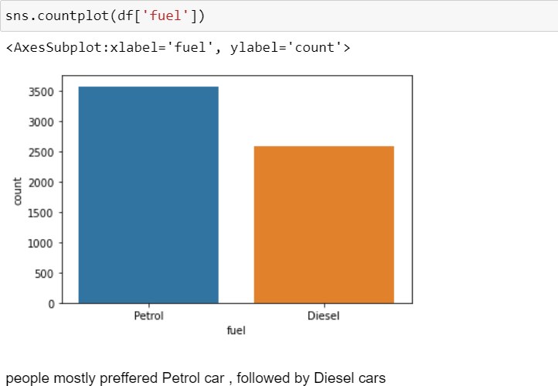
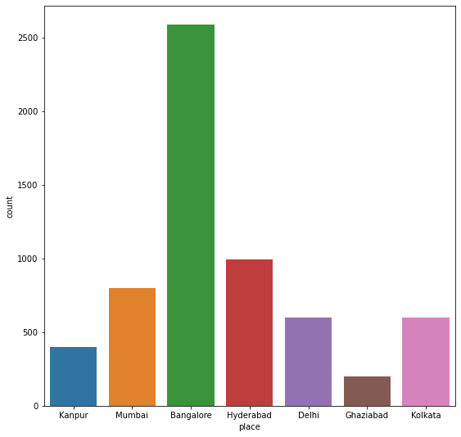
As per the collected data mostly used cars are traded in Bangalore ,
Mumbai , Hyderabad , delhi and least are traded in Kanpur , Ghaziabad , kolkata

Slide 7
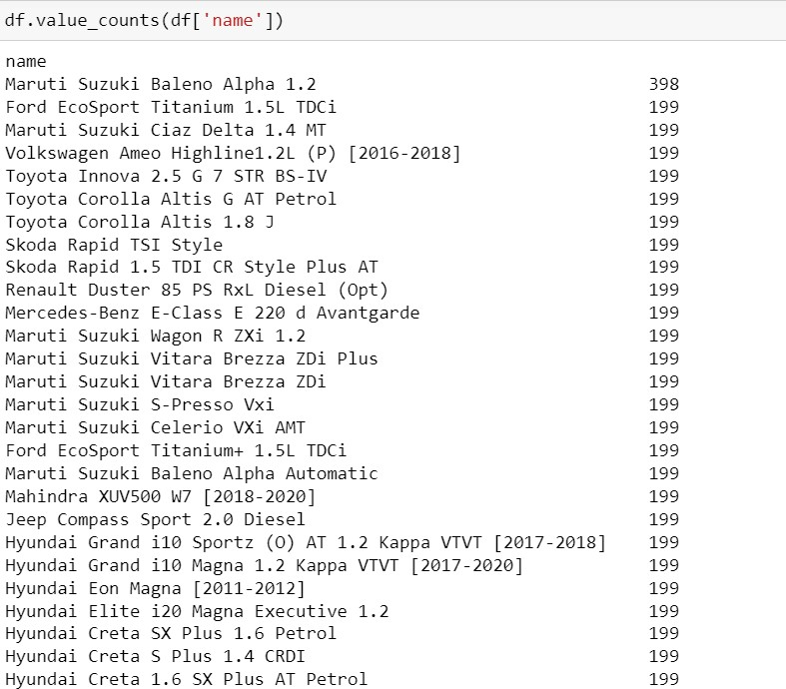
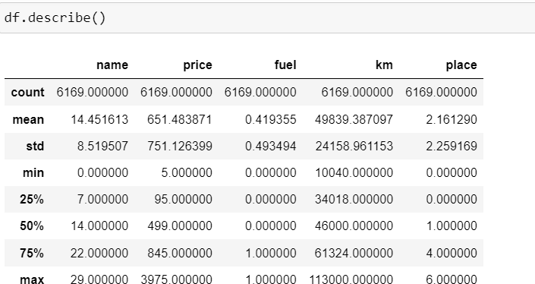
These are the above cars that are scrapped from the website and also i
which amount particular car is scrapped
Above is the statistical information about the data and they are as follows

Slide 8
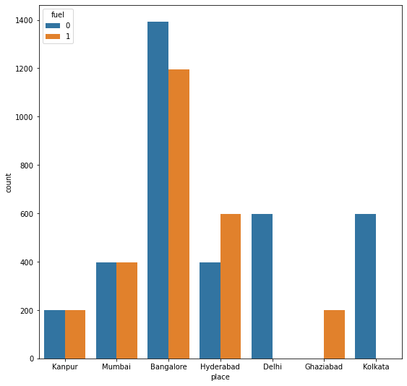
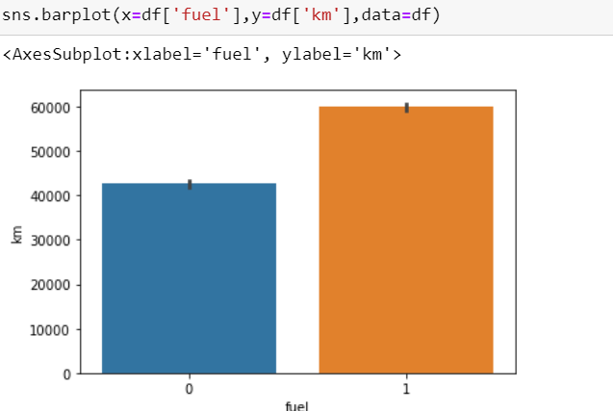
as per the data
petrol cars are more in demand as compared to diesel cars also the demand of LPG cars is the least
Banglore shows the petrol demand highest in number followed by delhi , kolkata , Hyderabad , mumbai , kanpur
also about diesel the demand is high in Bangalore , Hyderabad , mumbai , kanpur , Ghaziabad

Slide 9
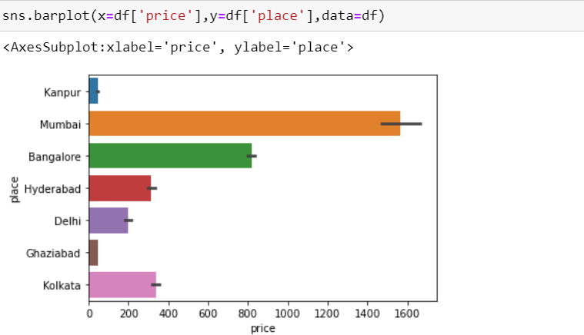
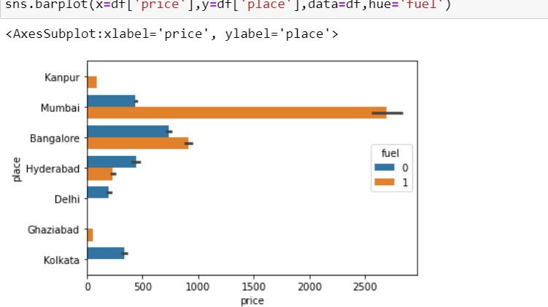
if we see the places with high cost they are as follows arranged in
descending order
1.Mumbai 2.Banglore 3.Kolkata 4.Hyderabad 5.Delhi 6.Kanpur

Slide 10
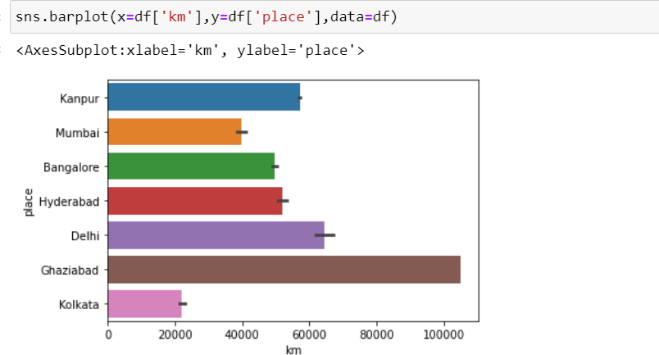
5.Kolkata
this bar plot shows the max or min car driver at various place and these are
as follows arranged in descending order
1.Ghaziabad 2.Delhi 3.Hyderabad 4.Kanpur 5.Bangalore 6.Mumbai 7.Kolkata

Slide 11
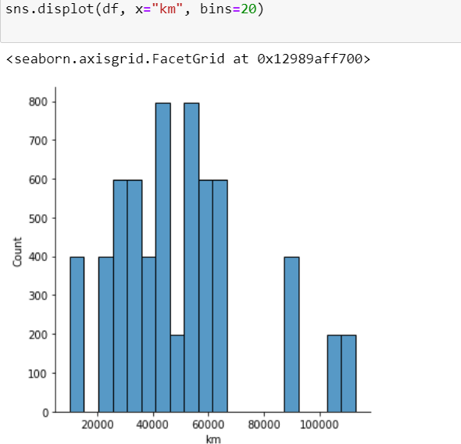
as per the figure
max cars are driven between 40,000 km to 60,000 km min cars driven around 10,000 km to 20,000 km
max car driven is more than 1,00,000 km

Slide 12
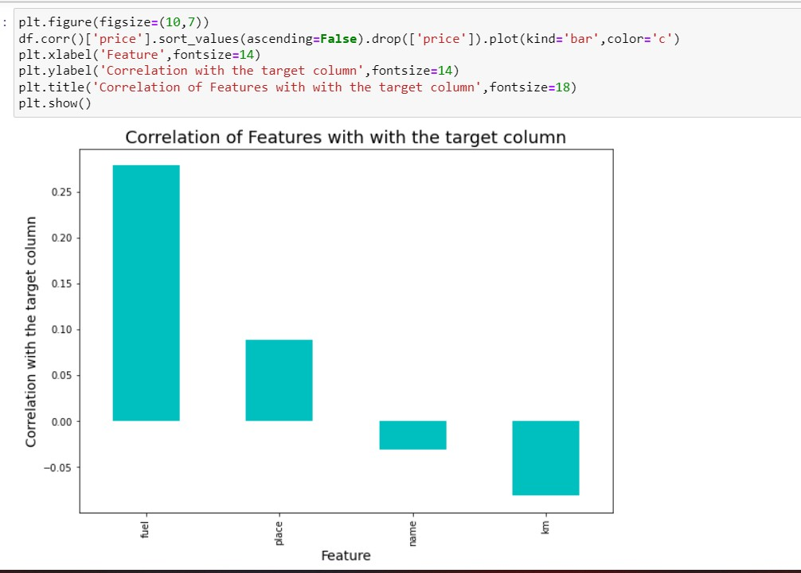
This figure shows the correlation and as per given data
max positive correlation is shown between price and fuel then positive correlation is shown between price and place then positive correlation is shown between price and name then
and at last there is negative correlation shows between km driven and price
About outliers
An outlier is an object that deviates significantly from the rest of the objects. They can be caused by measurement or execution error. The analysis of outlier data is referred to as outlier analysis or outlier mining.

Slide 13
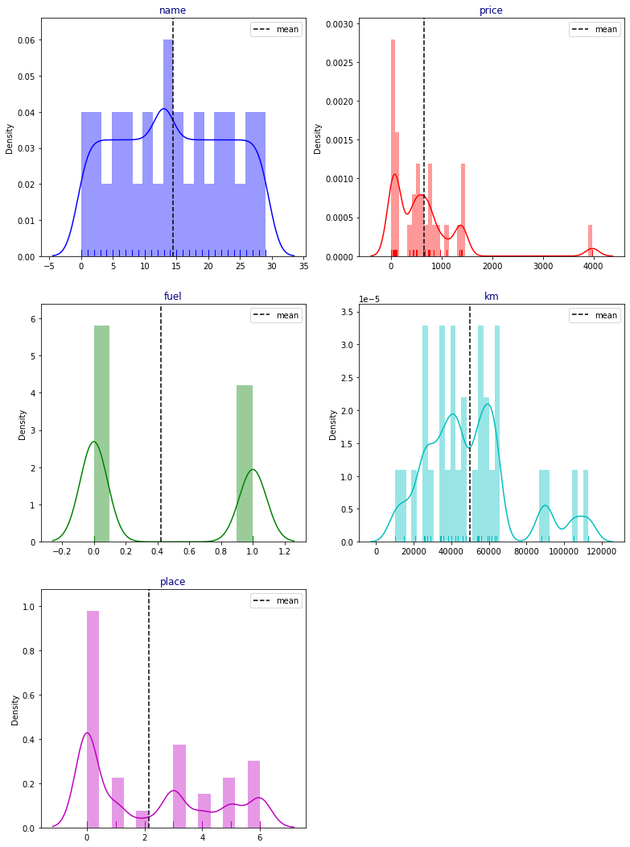
About skewness

Slide 14
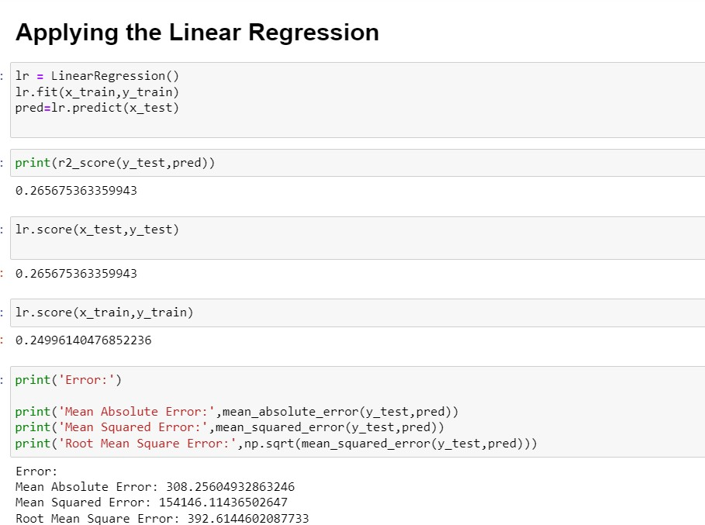
Now applying various algorithms for predicting the price of
cars
1 linear regression
In the most simple words, Linear Regression is the supervised Machine Learning model in which the model finds the best fit linear line between the independent and dependent variable i.e it finds the linear relationship between the dependent and independent variable.
Linear Regression is of two types: Simple and Multiple. Simple Linear Regression is where only one independent variable is present and the model has to find the linear relationship of it with the dependent variable
Whereas, In Multiple Linear Regression there are more than one independent variables for the model to find the relationship.

Slide 15
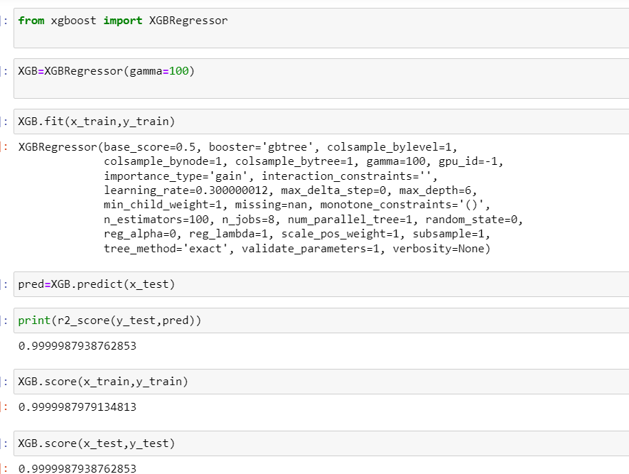
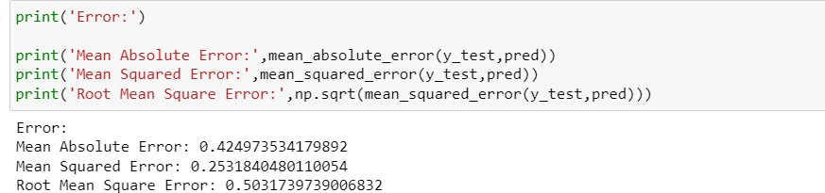
Then applying XG Boost
When using gradient boosting for regression, where the weak learners are considered to be regression trees, each of the regression trees maps an input data point to one of its leaves that includes a continuous score. XGB minimises a regularised objective function that merges a convex loss function, which is based on the variation between the target outputs and the predicted outputs. The training then proceeds iteratively, adding new trees with the capability to predict the residuals as

Slide 16
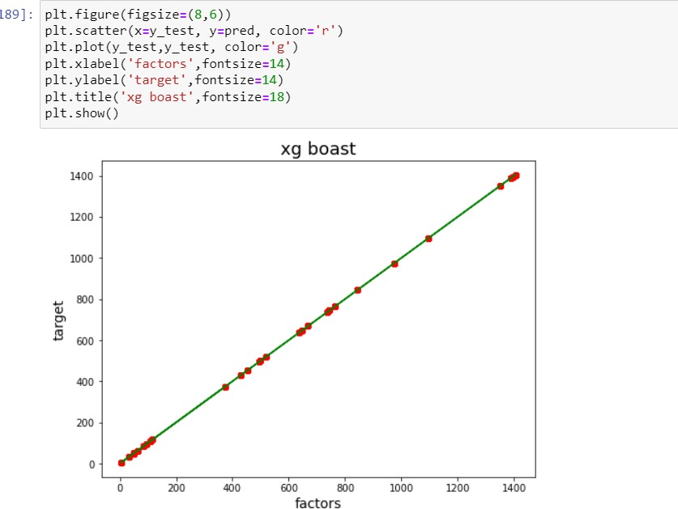

Slide 17
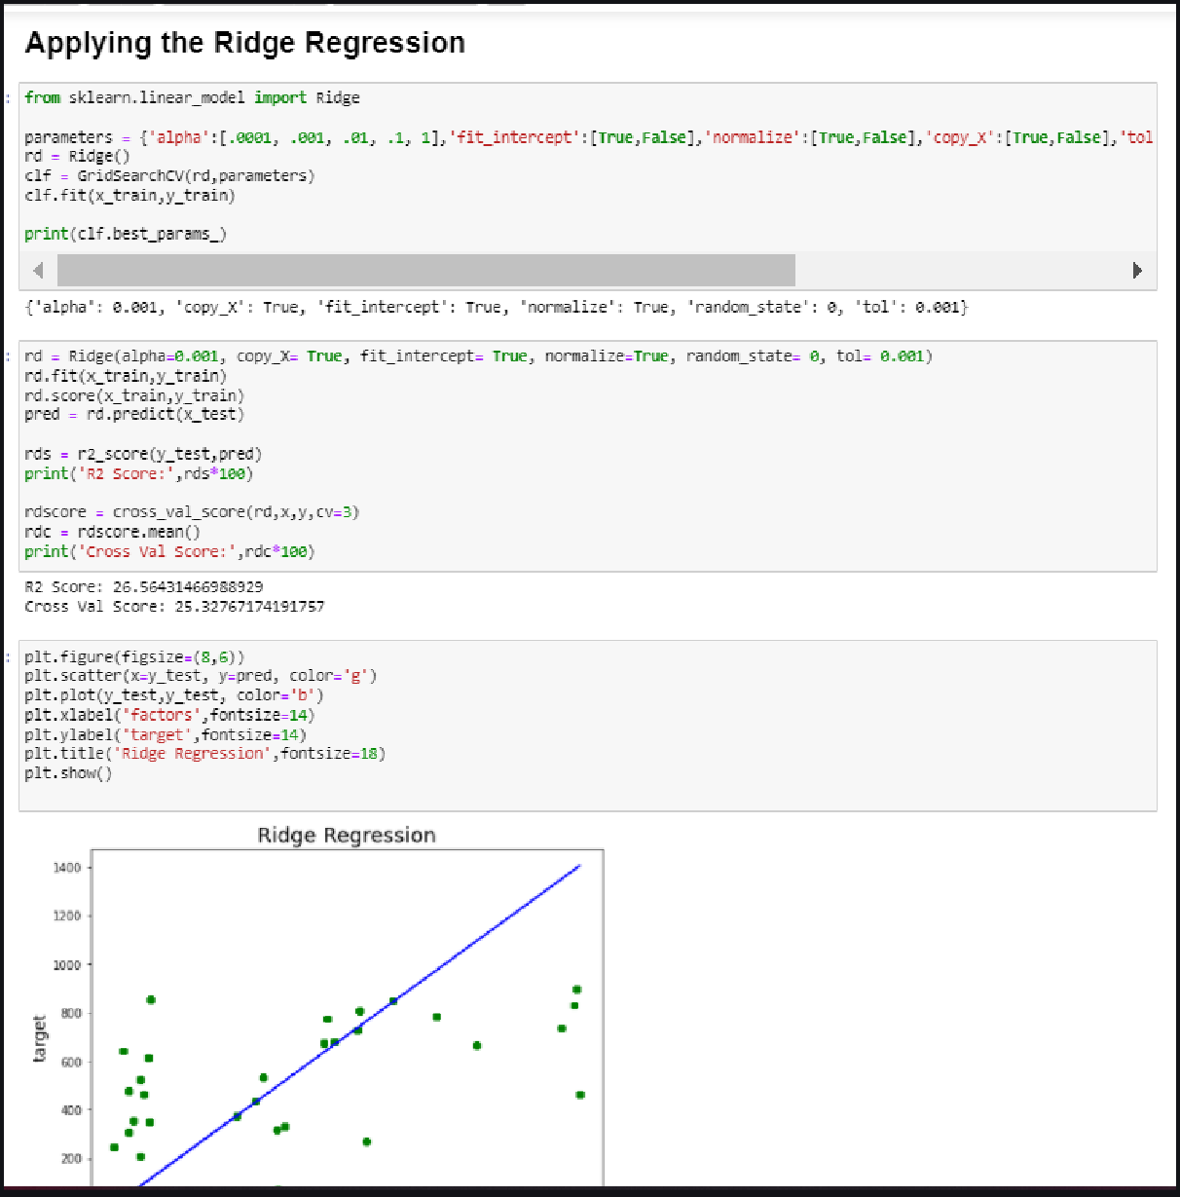
Ridge Regression :
In Ridge regression, we add a penalty term which is equal to the square of the coefficient. The L2 term is equal to the square of the magnitude of the coefficients. We also add a coefficient to control that penalty term. In this case if is zero then the equation is the basic OLS else if then it will add a constraint to the coefficient. As we increase the value of this constraint causes the value of the coefficient to tend towards zero. This leads to both low variance (as some coefficient leads to negligible effect on prediction) and low bias

Slide 18
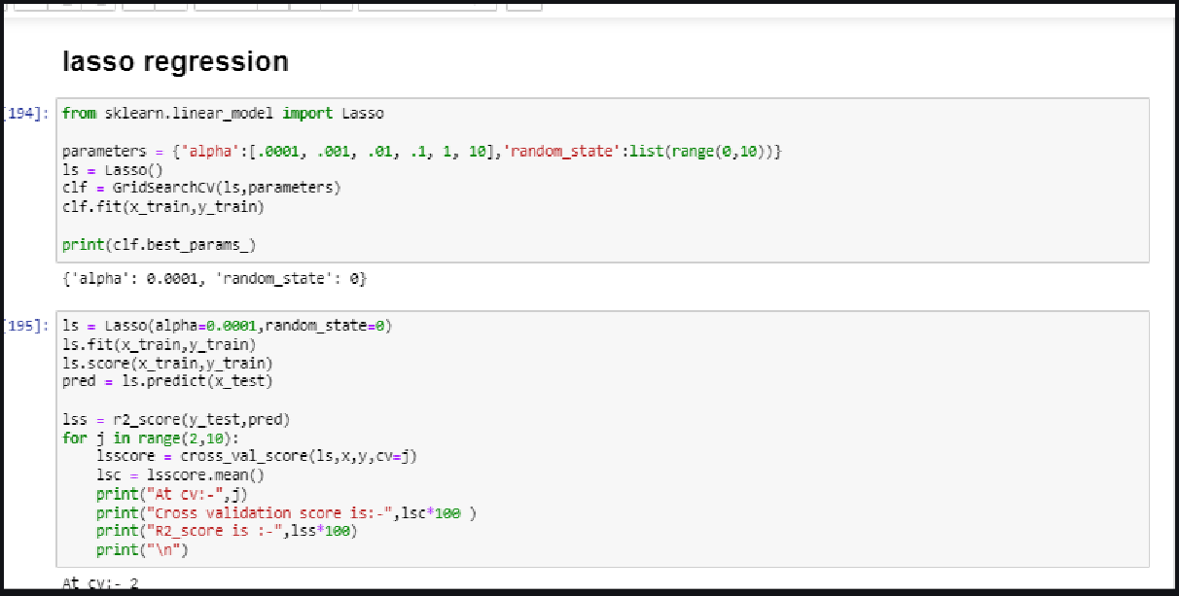
Lasso Regression :
Lasso regression stands for Least Absolute Shrinkage and Selection Operator. It adds a penalty term to the cost function. This term is the absolute sum of the coefficients. As the value of coefficients increases from 0 this term penalizes, causing the model to decrease the value of coefficients in order to reduce loss. The difference between ridge and lasso regression is that it tends to make coefficients to absolute zero as compared to Ridge which never sets the value of coefficient to absolute zero.

Slide 19
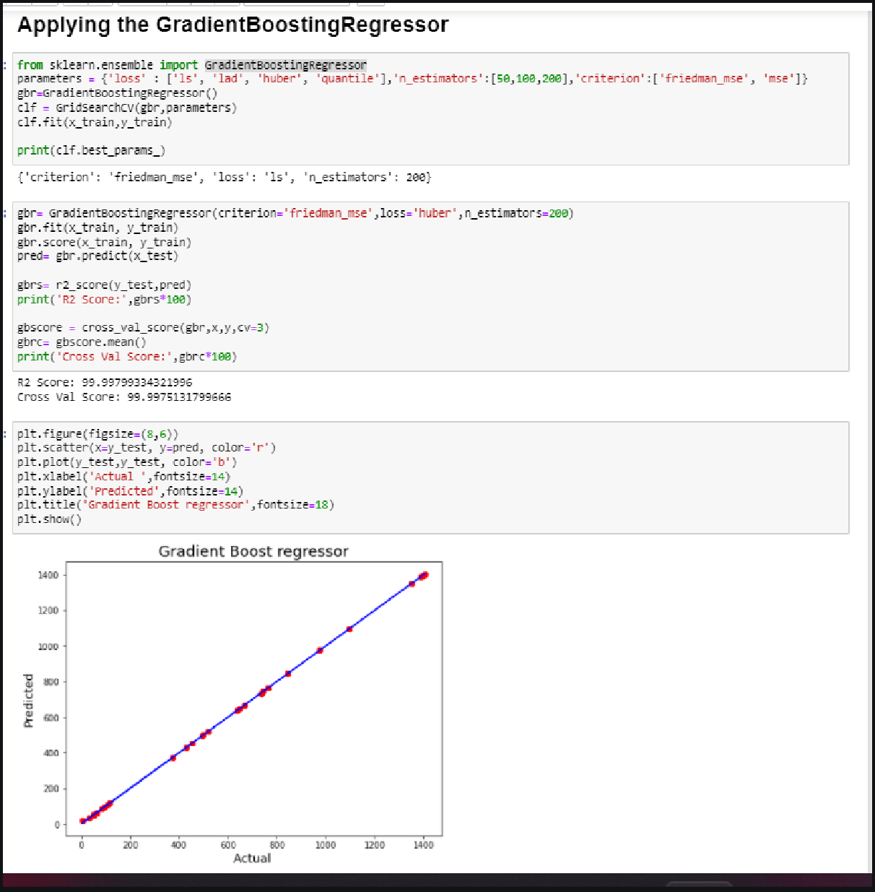
About gradient boosting
Gradient Boosting is a popular boosting algorithm. In gradient boosting, each predictor corrects its predecessor’s error. In contrast to Adaboost, the weights of the training instances are not tweaked, instead, each predictor is trained using the residual errors of the predecessor as labels.

Slide 20
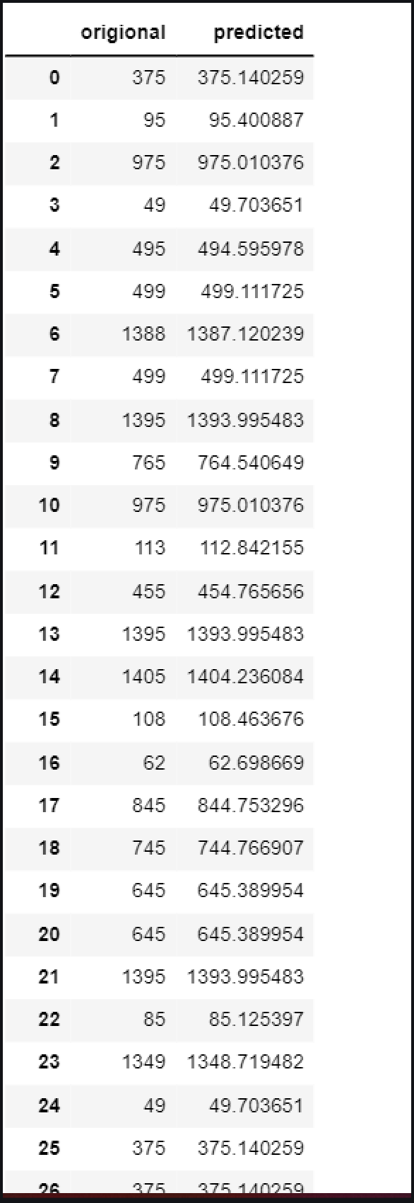
Example of our predicted results

Slide 21
Observation and conclusion
There is a huge demand of pre owned cars
Now people usually prefer petrol car over diesel car
Petrol car proved to be more cheaper in price as compared to diesel cars
There is a great demand of both Diesel and petrol cars in south india as compared to north
North indian car dealer may put their major focus over the petrol cars
There are some cities which can proved to be profitable if sales are increased
Maximum cars are demand between 30,000 km to 50,000 km

